Slide 1
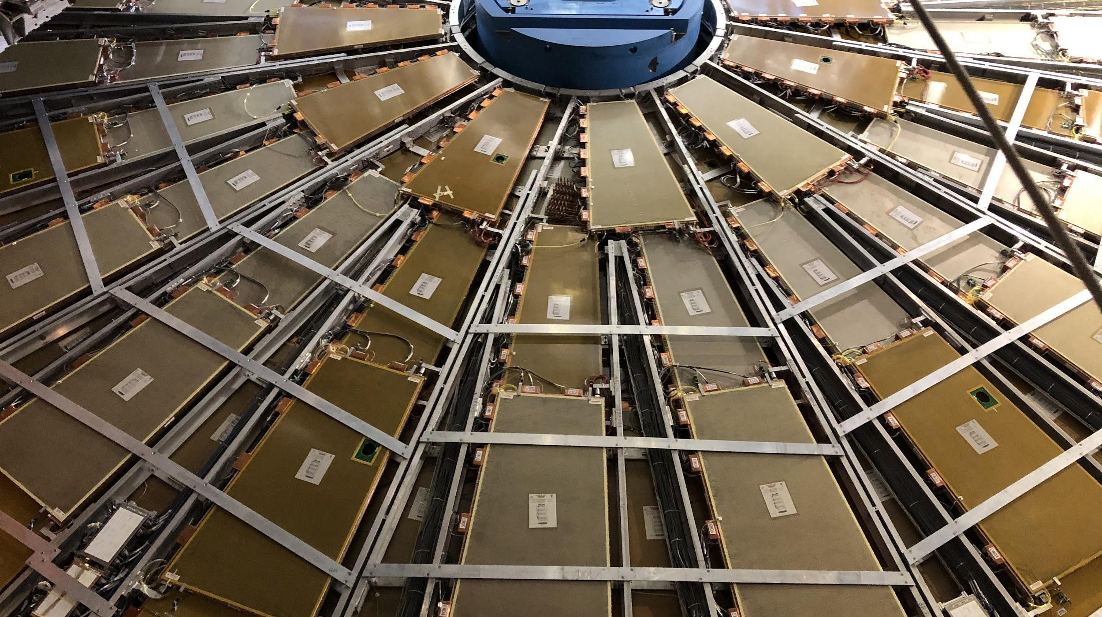

Maintenance Weekly
TileCal Op Meeting, 13 January 2022
Irakli Minashvili, Chris Thomas, Dawit Belayneh, Katie Hughes

Slide 2
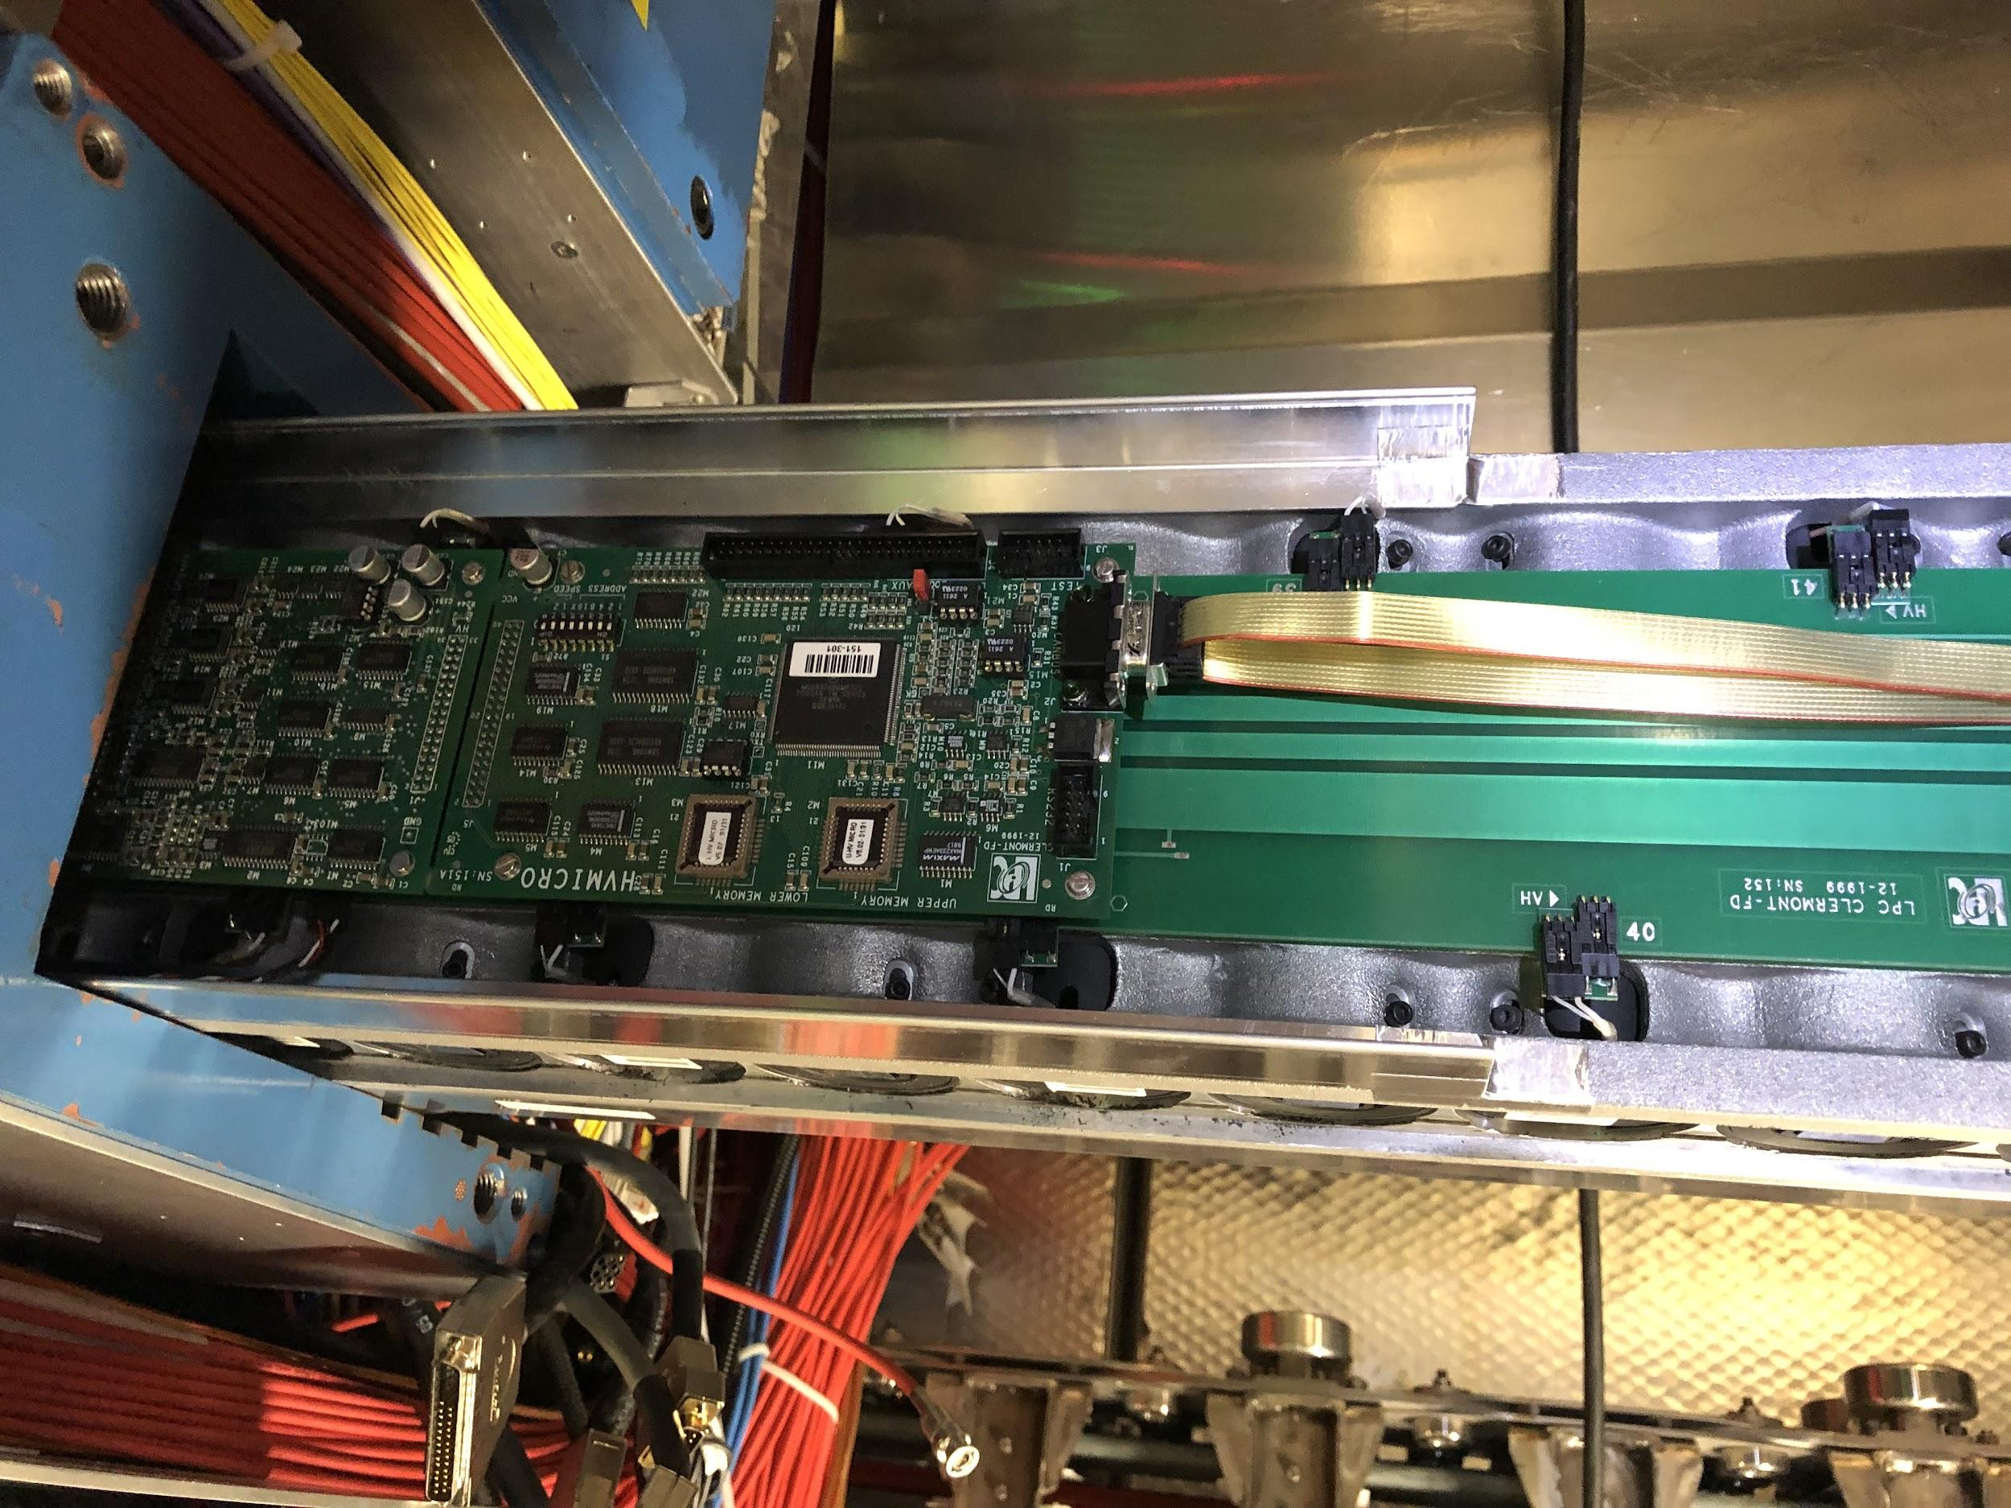
Maintenance Work
LBA 58
Opened drawer and replaced HV-micro
HV not fully recovered but more stable than before
LBC 18 (no finger)
Removed cloth cover and added plastic/aluminum tape cover

